Slide 1
FuelMart & Subway Safety Committee Meeting
Wednesday, December 18, 2019
2:00 PM Eastern
Corporate Office Conference Room and GoTo Meeting Web Conference

Slide 2
November 2019 Review:
Safety Topic – housekeeping
One employee reported injury
Two customer property damage incidents
Two submissions for Making Safety a Family Affair
No open safety concerns or suggestions for improvements

Slide 3
Incidents and Injuries From 11/29/2019 to 12/16/2019

Slide 4
Previous Injury – 11/17/19 Subway employee carrying a box of cookies tripped over a banana pepper box which was not put away during/immediately after the delivery. Injury resulted in days away from work. OSHA recordable injury.
Preventable by keeping walking areas clear and proper storage of products (housekeeping).
11/20/19 – Employee fell off step stool in walk in cooler. Injury resulted in days away from work. OSHA recordable injury.
12/02/19 – Employee picking up bread pan that fell on floor and experienced back pain. Injury resulted in days away from work. OSHA recordable injury.
recordable injury12/09/19 – Office chair broke. Employee fell to the ground and injured back. Injury resulted in days away from work. OSHA
Employee Injuries:

Slide 5
Customer injures
11.29.19 FM 641 Customer injury. A customer informed a FM employee that he lacerated his right arm on the fire extinguisher holder near diesel pump 15.
12.11.19 FM 645 Customer Fall. Customer walking into the store stepped between the bollards stepping on a chunk of ice causing her to fall on her left hip and wrist.

Slide 6
Date Range: Jan. 01, 2019 – Dec. 16, 2019 Company Total Incidents: 182 FuelMart & Subway Total Incidents: 82 (Previously 76) FuelMart & Subway employee injuries Reported: 18 FuelMart Property Damage and/or Vehicle Incidents: 24 FuelMart Customer Spills: 14 (10 spills at fuel pumps) FuelMart & Subway Customer injuries reported: 20 Other Incidents: 6

Slide 7
Safety Topic – Cold and Flu season

Slide 8
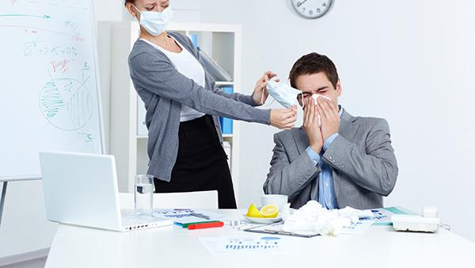
Preventing the spread of colds & flu

Slide 9
Flu season
It is estimated that one billion colds are caught annually in the united States.
According to the centers for disease control and prevention, 3%-11% of the U.S. population catches the flu annually.

Slide 10
The flu season in the u.s ranges from November-April
While it is a myth that cold temperatures cause colds, it’s true that cold weather keeps people indoors, making exposure more likely.

Slide 11
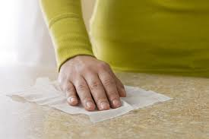
Tips to avoid colds & flu
Clean & wipe down shared surfaces such as countertops, keyboards & phones.
Avoid touching your mouth, nose & eyes, & wash hands thoroughly and often.
Get a flu shot if possible-it’s most important for children & elderly.

Slide 12
Tips to avoid colds & flu cont.
Eat healthy foods to strengthen your immune system.
Exercise moderately to maintain a healthy immune system.
Ask your doctor about vitamin supplements to help support your immune system.

Slide 13
Tips to avoid colds & flu cont.
Drink plenty of water to stay hydrated.
Get plenty of rest.
Try to avoid people who are sick & know when to stay home if you become sick.

Slide 14
Flu symptoms
High fever 102-104 degrees Fahrenheit, headache, extreme fatigue, dry cough and sore throat, runny or stuffy nose, muscle aches and nausea, vomiting and diarrhea.

Slide 15
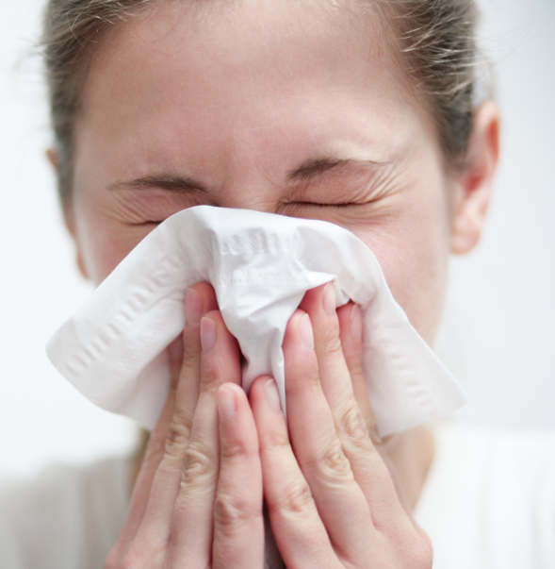
Cold symptoms
Sore throat, cough, chest discomfort, mild fatigue, fever & headache are rare, runny nose.

Slide 16
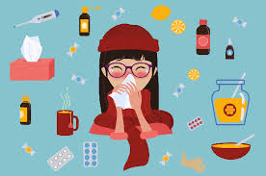
Complications of the flu
Complications may Include Pneumonia, dehydration & worsening of conditions like congestive heart failure, asthma, diabetes or sinus & ear infections in children.

Slide 17
Complications of the flu
Most at Risk are children, Elderly and People with certain health conditions.

Slide 18
Stop the spread of germs
Germs are spread in respiratory droplets caused by coughing and sneezing. They usually spread from person to person, though sometimes people can become infected by touching something contaminated by germs.

Slide 19
Infection can occur
1 day before & up to 5 days after becoming sick

Slide 20
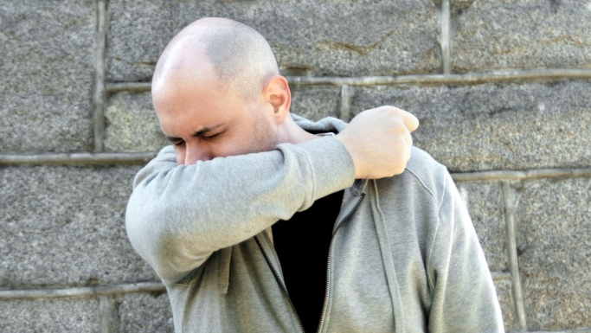
Prevent the spread of germs
Cover your nose & mouth when you sneeze or cough
Use tissues when you sneeze or have sniffles
Sneeze into your sleeve if tissues aren’t available

Slide 21
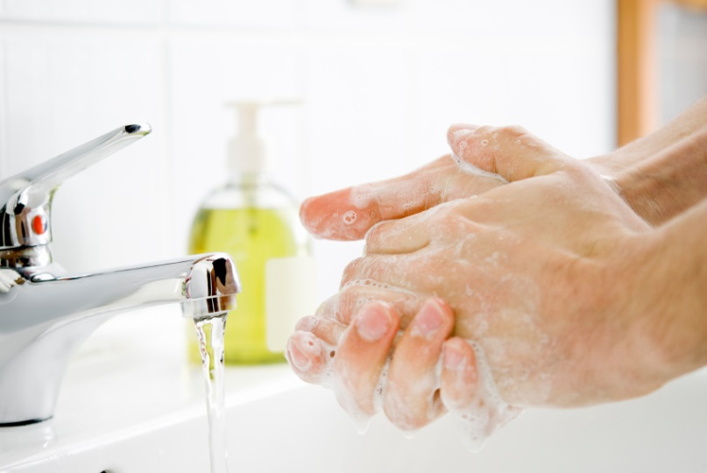
Prevent the spread of germs
Toss your tissues in the trash
Wash hands frequently: any kind of soap is effective in removing germs if you vigorously rub your hands together for at least 15-30 seconds and rinse well under running water.

Slide 22
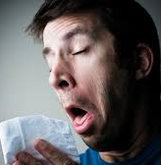
Work or stay home?
Let common sense be your guide!
Stay home if you: have a fever or cannot control your sneezing & coughing

Slide 23
When in doubt, call your physician!
Don’t overtax your immune system.
Common colds become more serious bacterial infections such as sinusitis – and influenza can turn into pneumonia.

Slide 24
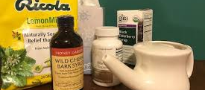
Over-the-counter medications
Check label & ingredients, talk to pharmacist, some cold and flu medicines (with antihistamines)can make you drowsy and that can be dangerous when driving or working around any kind of machinery and can negatively react with your regular medications.

Slide 25
Cold and flu facts pop quiz!
True or False: Cold temperatures outside cause colds and flu
True or false: flu season ranges from December through march.
Which of the following tips for avoiding colds and flu are correct? Select all that apply
a. High fever 102-104 °F
b. Rash
c. nausea, vomiting and/or diarrhea
d. Muscle aches
True or false: eating healthy foods and participating in moderate exercise can help avoid the flu
True or false: a person is only contagious when they have a fever.

Slide 26
Making Safety A Family Affair
Want to Add 500 points to your card

Slide 27
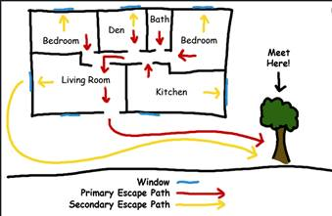
Making Safety A Family Affair
Share a photo that depicts you and your family conducted a home fire drill at your outside meeting location with a sign promoting fire safety at home, fire prevention month, house evacuation map, etc.

Slide 28
Making Safety A Family Affair
Helen Evans
Cody Secrest
500 points will be added to your card.

Slide 29
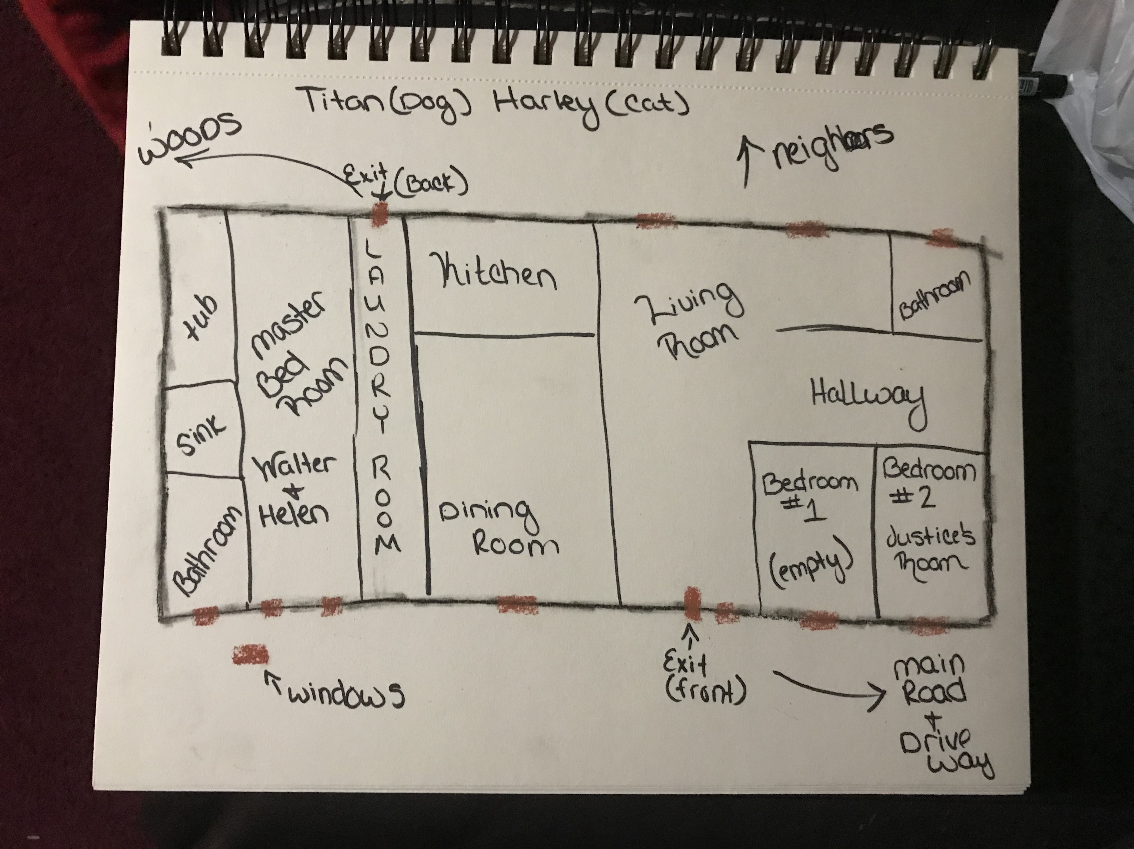
Submitted by cody secrest 783
Submitted by Helen Evans 783

Slide 30
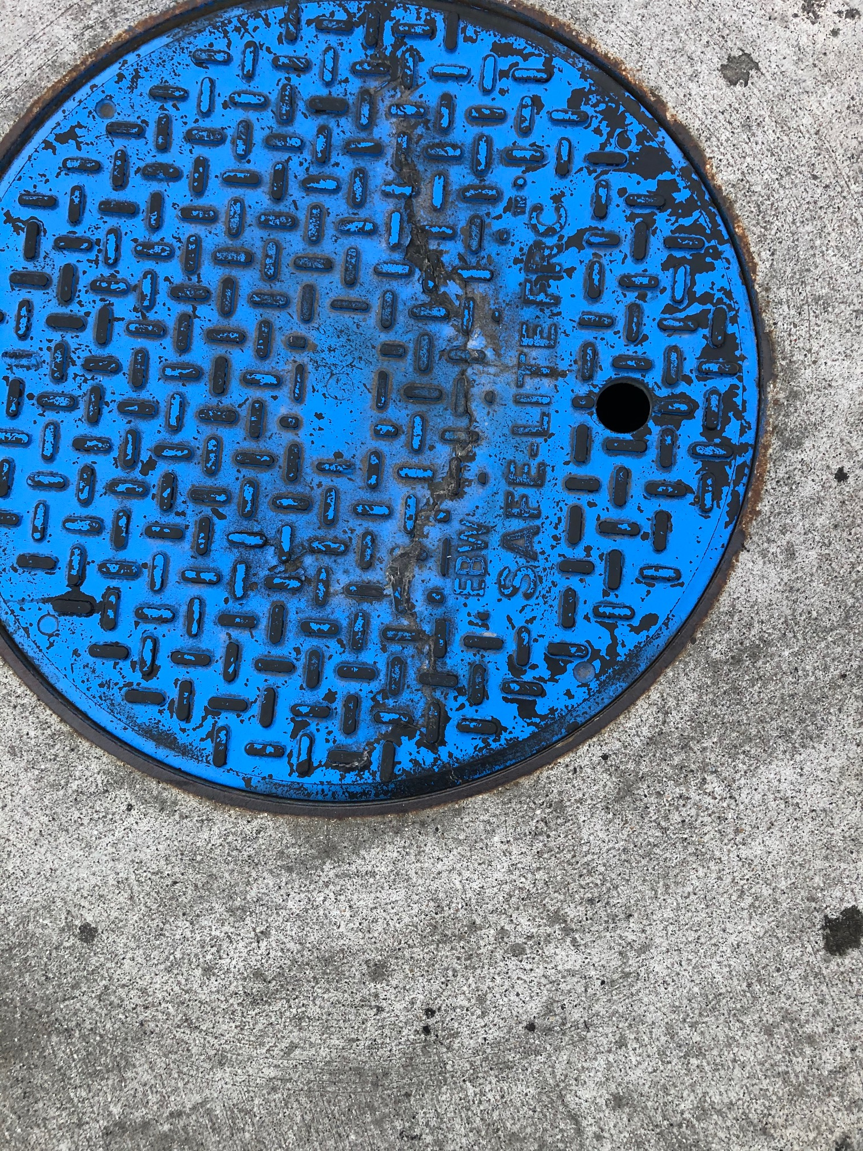
Driver concerns:
12/9/19 A fuel delivery driver indicated both of the regular diesel tanks plungers are broken and there is mud in both vapor tube buckets or the fill drop tube bucket at FM 783
12/9/2019 Fuel delivery driver indicated the mid-grade tank cover is cracked at FM 641.
12/11/19 Tank cover was replaced

Slide 31
Open Floor
Please remember when filling out your monthly safety inspections to send Lisa Hamilton a separate email or comment in the subject line if there are any missing labels/stickers/signs that need replaced.
Next meeting 1/22/2020
Thank you!

